Slide 1
Code Abhyaas Basics -- 06

Slide 2
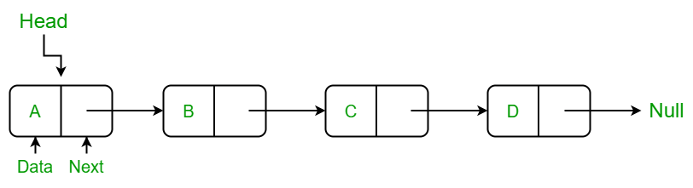
Singly linked list
Singly linked list is a data structure used for collection of nodes and has following properties.
It contains sequence of nodes.
A node has data and reference to next node in a list
First node is the head node.
Last node has data and points to null.

Slide 3
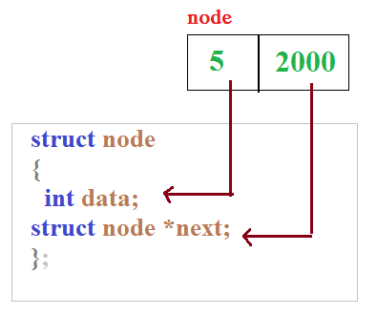
A Linked List Node

Slide 4
Operations
Creation
Insertion at first
Insertion at middle
Insertion at end
Deletion at first
Deletion at middle
Deletion at end

Slide 5
1.Program to reverse a single linked list.
Sample Input: 10 20 30 40 50
Sample Output: 50 40 30 20 10

Slide 6
2.Program to search for an element in the singly linked list.
Sample Input: 3
Sample Output: 3 is present at 3rd node.

Slide 7


